Slide 1
Concurrency: Mutual Exclusion and Synchronization
Chapter 5 – William Stallings

Slide 2
Background
Operating systems are responsible for management of processes
In a uniprocessor or multiprocessor system, multiple processes coexist.
Multiple processes in various states of execution
Processes compete for resources
Processes also cooperate for solving a common problem

Slide 3
Background
Assume the following two processes are running concurrently. Both of them access the same variable x.
Process A{ | Process B{
for (int I=0; I<5; I++) | for (int I=0; I<5; I++)
x = x + 1; | x = x + 1;
} | }

Slide 4
Background
The statement
x = x + 1
will be compiled as follows:
load R1, x (1)
add R1, #1 (2)
store x, R1 (3)
When the two processes are done, the result could be any value from 2 to 10, depending on the order in which the above 3 statements are executed by the processes A and B.

Slide 5
Background
Lesson –
Simultaneous access to shared data may result in data inconsistency.
The portion of the code in each process, running concurrently with others, that accesses shared data is called a Critical Section.
Maintaining data consistency requires that the Critical Section of each process be executed mutually exclusively.

Slide 6
Another Example
Consider a system with a number of resources. To keep track of resources, a linked list is maintained.
The head of the linked list points to the first resource. The link in the first node points to the next resource, and so on.
The allocate routine may be coded somewhat as follows:
allocate(listptr *head){
int id;
id = head → resource_id;
allocate resource with identification = id to the calling process;
head = head→link;
}

Slide 7
Example
Suppose processes P1 and P2 request for a unit of resource.
While the system is processing request for P1 through the function allocate, it is interrupted just before it has reset the value of head.
Let us say the system has taken up the request from P2 before the allocate routine was able to reset the value.
It allocates the resource to P2. The same resource is allocated to two different processes.

Slide 8
Example
Lesson 2
When processes compete for resources, if proper care is not taken, the same resource may be allocated to two different processes. Also, a resource may not be allocated, but it does not show up in the list of available resources.
Again this problem could have been avoided if allocate() function was executed mutually exclusively

Slide 9
Some Definitions
Race condition
A situation in which multiple threads or processes read and write a shared data item and the final result depends on the relative timing of their execution
Atomic operation
A function or action implemented as a sequence of one or more instructions that appears to be indivisible; i.e. No other process can see an intermediate state or interrupt the operation. The sequence of instructions is guaranteed to execute as a group, or not execute at all, having no visible effect on system state.

Slide 10
Definitions
Mutual exclusion
The requirement that when one process is in a critical section that accesses shared resources, no other process may be in a critical section that accesses any of those shared resources
Livelock
A situation in which two or more processes continually change their states in response to changes in the system without doing any useful work
Deadlock
A situation in which two or more processes are unable to proceed because each is waiting for one of the others to do something
Starvation
A situation in which a runnable process is overlooked indefinitely by the scheduler; although it is able to proceed, it is never chosen

Slide 11
Concurrency – some principles
Interleaving and overlapping
Can be viewed as examples of concurrency
Both present the same problems
The relative speed of the execution of processes cannot be predicted
Depends on activities of other processes
Interrupts
Scheduling policies

Slide 12
Some OS concerns because of concurrency
The OS must
Be able to keep track of various processes
Allocate and de-allocate resources for each active process
Protect the data and physical resources of each process against interference by other processes
Ensure there is no race condition

Slide 13
Critical Section Problem
The Critical Section Problem is how to provide access to the concurrently running processes to the shared variables to ensure correct functioning.
-- need to provide mutual exclusion.
Mutual Exclusion. If process Pi is executing in its critical section, then no other process can be executing in its critical sections that accesses the same variables as Pi.
Providing mutual exclusion is tricky.

Slide 14
Mutual exclusion
Any solution that provides mutual exclusion, should also ensure the following:
Progress. If no process is in its critical section and some process(es) wish to enter its(their) critical section, decision on which of the processes enters its CS should not be postponed indefinitely.
Bounded Wait. When a process attempts to enter its CS, there must be a bound on the number of times other processes are allowed to enter their critical section before it is allowed to enter its CS.

Slide 15
Some assumptions
Relative speed of processes unknown but non-zero
Read/write are atomic operations. Simultaneous memory access requests are resolved arbitrarily.
A process may stop outside of, but not inside, its critical section
A process remains inside its critical section for a finite time only
No priority can be assigned to any process.

Slide 16
General Structure of Processes
We assume processes have the following structure:
process I{
while (true){
…
…
Critical Section
…
…
}
}
To provide mutual exclusion, need to add code before and after the Critical Section of each process.

Slide 17
CS Problem – Software Solutions
Consider only two concurrent processes.
Introduce a shared variable (integer) turn; turn = 0 or 1; initially let turn = 0;
/* turn = i implies process i is in its CS. */
process i{ /* i is 0 or 1 */
while (true){
…
while (turn != i) do {}
Critical Section
turn = (i + 1) % 2;
…
}
}

Slide 18
Software solution
This solution provides the mutual exclusion, because at any given time turn can be either 0 or 1
Progress – not satisfied; processes enter CS alternately. Also if one process stops outside of its CS, the other will wait indefinitely.
Bounded wait – satisfied (so long as both processes are running).

Slide 19
Another Solution
In the first attempt, each process only checks whether it is its turn or no; the processes do not know the state of the other process.
In the second attempt each process checks the state of the other process before deciding to enter its CS.
Towards this end, introduce two shared variables;
flag[i], i= 0 or 1;
flag[i] = true ➔ process i is in its CS
We now have the following code:

Slide 20
Solution (contd.)
initially let flag[i]= false, for i = 0 and 1;
process i{ /* i is 0 or 1 */
while (true){
…
while (flag[(i+1) % 2) do {}
flag[i] = true;
Critical Section
flag [i] = false;
…
}
}

Slide 21
Solution (contd.)
This solution not acceptable, because Mutual exclusion – not satisfied;
One process makes a decision about the state of the other before the other makes a change in its state.
If we correct this by interchanging the two statements above the Critical Section, the mutual exclusion will be satisfied, but the two processes may wait for ever at their respective “while” statements, i.e. progress and bounded wait not satisfied.
A correct solution is obtained by combining the two approaches together;

Slide 22
Peterson’s Solution
Introduce 3 new shared variables as follows:
Turn : 0 or 1;
Flag[i], i = 0 or 1;
Flag[i] is true or false;
Initially, turn = 0; flag[0], flag[1] = false;
Variables flag[] and turn have the same meaning as before.

Slide 23
Peterson’s Solution (contd.)
process i{ /* i is 0 or 1 */
while (true){
…
flag[i] = true;
turn = (i + 1) % 2;
while (flag[(i+1) % 2 ] & turn == (i+1) % 2) do {;}
Critical Section
flag [i] = false;
…
}
}

Slide 24
Peterson Solution – Correctness
Mutual exclusion – satisfied;
For two processes to be in their CS simultaneously, need to have flag[0], flag[1] = true; and turn = 0 and 1, simultaneously; but this is not possible, because each process checks these values after they have changed the values. Though flag[0] and flag[1] can be false simultaneously, turn can have either a value of 0 or 1, which will allow one of them to enter its CS, and the other will have to wait till the value of turn is changed.

Slide 25
Peterson’s Solution – Correctness
Progress and Bounded Wait – satisfied;
Suppose process 0 is stuck in its while loop ➔ flag[1] = true and turn = 1; This will allow Process 1 to get into its CS after it sets turn to 0; After the process 1 gets out of CS, it will set flag[1] to false, which will allow process 0 to enter its CS. However, it is quite possible that before process 0 is able to check the value of flag[1], process P1 is fast enough to reset the value of flag[1] to true. But then sooner or later, it will set turn to 0, which will allow process 0 to enter its CS and block process 1 to enter its CS. Thus, if the two processes want to enter their CS simultaneously, they will enter their CS alternately in some order.

Slide 26
Mutual Exclusion – Hardware Support
Software solutions tricky and difficult to understand
Even more difficult when number of processes involved is more than 2
Some hardware features can facilitate solution and improve efficiency
In uniprocessor systems may disable interrupts
Disabling interrupts guarantees mutual exclusion
The efficiency of execution could be noticeably degraded
The approach does not work on a multiprocessor system

Slide 27
Mutual exclusion – Hardware support
We need an atomic mechanism to check and change a location
Two hardware instructions
Test and Set (TS): tests and modifies the contents of a memory location as an atomic operation
Swap: Exchanges the contents of two memory locations atomically

Slide 28
Test-and-Set
The Test-and-Set instruction tests and modifies the contents of a location as an atomic operation. The instruction performs the following operation atomically.
boolean Test_and_Set (boolean target) {
boolean temp;
temp = target;
target = true;
}

Slide 29
Mutual Exclusion using Test_and_Set
May use the Test-and-Set instruction to provide mutual exclusion as follows:
Initially, Boolean lock ← false;
/* lock = true implies some process is its critical section. */
Process I {
while(true){
…
while (Test_and_Set(lock)) do {}
Critical Section
lock = false;
…
}
}

Slide 30
Test_and_Set – correctness
The solution provides mutual exclusion for any number of concurrent processes.
Since the Test_and_Set operation is atomic, only one process can test value of lock at any time
Also satisfies the progress requirement
However, does not guarantee bounded wait.
To provide bounded wait, need to include code that will choose the next process to enter the CS, instead of letting every process compete for entry into the CS.

Slide 31
SWAP
The SWAP instruction works as follows:
void Swap (int a, int b){
int temp = a;
a = b;
b = temp;
}
The instruction is executed atomically.

Slide 32
Solution using SWAP
As before, let lock be a shared boolean variable, with initial value false.
Process I {
boolean key;
while(true){
…
key = true;
repeat
Swap(lock, key)
until (not key);
Critical Section
lock = false;
…
}
}

Slide 33
Providing Bounded Wait
The previous two solutions do not provide bounded wait. To do so, we need to add some additional code before and after the critical section.
In addition to the variable lock, we use an additional variable for each process that tells whether or not the process is intending to enter its CS.
Let intent[n] be an array of n Boolean variables, where intent[i], i = 0 … n-1, gives intention of process i to enter its critical section. All these n variables are shared with an initial value false;

Slide 34
Providing Bounded Wait
Process i{
int j;
boolean key;
while (true){
…
intent[i] = true;
key = true;
while(intent[i] & key) do
swap(lock, key);
intent[i] = false;
Critical Section

Slide 35
Providing Bounded Wait
j = i + 1 mod n;
while ((j != i) & (not intent[j]))
j = j + 1 mod n;
if (j == i)
lock = false;
else
intent[j] = false;
…
…
}
}
This will ensure that any intending process will be able to enter its Critical Section after every other process has taken at most one turn at CS.

Slide 36
Providing Bounded Wait
Mutual Exclusion: A process may enter its CS only if key is false, or its corresponding variable intent[i] is false. If a process finds both these values to be true when in the while loop, it will wait until a process leaving its CS, sets one of these two variables to true. Also, note that only the process leaving the CS can change one of these variables. Thus, mutual exclusion is satisfied.
Bounded wait: A leaving process i allows the first process in the sequence
i+1, …, N-1, 0, 1, … , i – 1
that is ready to go into its CS.

Slide 37
Advantages of Special machine instructions
Applicable to any number of processes on either a single processor or multiple processors sharing main memory
Simple and easy to verify
It can be used to support multiple critical sections; each critical section can be defined by its own variable

Slide 38
Disadvantages
Busy-waiting is employed, thus while a process is waiting for access to a critical section it continues to consume processor time
Starvation is possible when a process leaves a critical section and more than one process is waiting

Slide 39
Semaphore
A semaphore is a synchronization tool. It is an integer variable.
Only the following 3 operations can be performed on a semaphore.
Initialize: A semaphore can be given an initial value.
semWait(S): Decrements the value of a semaphore; the calling process may have to wait
semSignal(S): Increments the value of a semaphore; a blocked process is allowed to proceed
No other operation can be performed on a semaphore to inspect or manipulate the value of a semaphore

Slide 40
Consequences
No way to know before a process decrements whether it will block or not
No way to know which process will continue immediately when two processes are running concurrently
Don’t know if another process is waiting; so the number of processes unblocked on a binary semaphore is zero or one

Slide 41
Semaphore Primitives
A semaphore has a value and an associated list of processes waiting on the semaphore.
May define a semaphore as follows:
typedef struct{
int value;
list L; /* L is a list of waiting processes*/
} semaphore;
void semWait(semaphore s){
s.value = s.value – 1;
if (s.value < 0) {
add process to s.L;
block the process;
}
}
void semSignal(semaphore s){
s.value = s.value + 1;
if (s.value <= 0){
remove a process from s.L;
add the removed process to the ready list;
}
}

Slide 42
Binary Semaphore
A binary semaphore can assume only two values (0 or 1)
typedef struct{
enum (zero, one) value;
list L; /* L is a list of waiting processes*/
} binary_semaphore;
void semWaitB(binary_semaphore s){
if (s.value == one) s.value = zero;
else{
add process to s.L;
block the process;
}
}
void semSignalB(binary_semaphore s){
if (s.L == NULL) s.value = one;
else{
remove a process from s.L;
add the removed process to the ready list;
}
}

Slide 43
Strong/Weak Semaphores
Weak Semaphores
The order in which processes are removed from the wait list L is not specified
Strong Semaphores
The wait list L is implemented as a FIFO queue. The process that has been blocked for the longest time is the first to be unblocked

Slide 44
Mutual Exclusion using Semaphores
Semaphore is used for mutual exclusion as follows:
Let S be a shared semaphore with initial value 1;
Code for process i will be as follows:
process i{
while (true){
…
semWait(S);
Critical Section;
semSignal(S);
…
}
}

Slide 45
Producer-Consumer Problem
Two types of processes running concurrently
All the processes share a common buffer
One type of processes, called producers, generate data that is placed on the shared buffer
There is one consumer process that removes data from the buffer and uses it
Requirements
If buffer is full producers must wait for buffer to become not full before placing data on the buffer
If buffer is empty consumer must wait for some producer to place data into the buffer before removing it
Only one process (producer or consumer) can access the buffer at a time

Slide 46
Solution
The buffer is implemented as a first-in-first-out circular queue
We assume two operations on this queue:
append(data) adds an entry at the tail of the queue
Take(data) removes an entry from the head of the queue

Slide 47
Solution using binary semaphore
binary_semaphore s = 1, delay = 0;
int n = 0;
void producer(){
while(true){
produce(data);
semWaitB(s);
append(data);
n++;
if (n == 1) semSignalB(delay);
semSignalB(s);
}
}
void consumer(){
semWaitB(delay);
while(true){
semWaitB(s);
take(data);
n--;
semSignalB(s);
consume(data);
if (n == 0) semWaitB(delay);
}
}

Slide 48
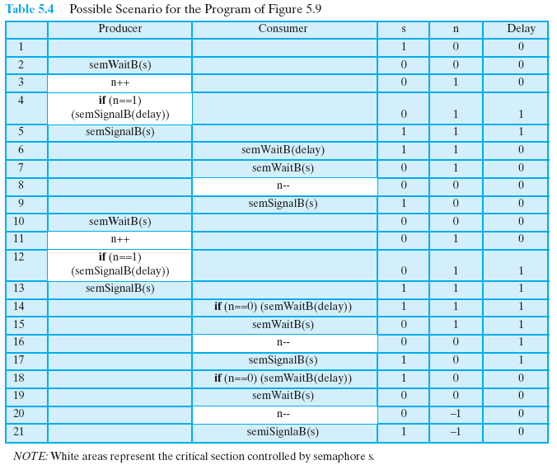
Solution Incorrect!!

Slide 49
Correct Solution
binary_semaphore s = 1, delay = 0;
int n = 0;
void producer(){
while(true){
produce(data);
semWaitB(s);
append(data);
n++;
if (n == 1) semSignalB(delay);
semSignalB(s);
}
}
void consumer(){
int m; /* m is a local variable */
semWaitB(delay);
while(true){
semWaitB(s);
take(data);
n--; m = n;
semSignalB(s);
consume(data);
if (m == 0) semWaitB(delay);
}
}

Slide 50
Solution using semaphores(finite buffer)
semaphore full = 0, empty = n, mutex = 1;
void producer(){ void consumer(){
while(true){ while (true){
…
produce(data); semWait(full);
… semWait(mutex);
semWait(empty); take(data);
semWait(mutex); …
append(data); semSignal(mutex);
… semSignal(empty);
semSignal(mutex); …
semSignal(full); consume(data);
… …
} }
} }

Slide 51
Implementation of Semaphores
semWait() and semSignal() must be atomic operations
Can be implemented in hardware or firmware
May use software solutions like Peterson’s algorithm for mutual exclusion
Or may use one of the hardware supported schemes for mutual exclusion

Slide 52
Monitors
A monitor is a high-level abstraction that provides thread safety.
Only one thread may be active within the monitor at a time.
Implemented in a number of programming languages
including Concurrent Pascal, Pascal-Plus, Modula-2, Modula-3, and Java
Has also been implemented as a program library
Software module consisting of one or more procedures, an initialization sequence, and local data

Slide 53
Monitor characteristics
Local data variables are accessible only by the monitor’s procedures and not by any external procedure
A process enters monitor by invoking one of its procedures
At most one process may be executing in the monitor at any given time

Slide 54
Synchronization in Monitors
A special type of variable, called condition variables, are used to provide synchronization mechanism
Condition variables can only be defined within a monitor
Only two operations can be performed on a condition variable
cwait(cv): calling process is blocked
csignal(cv): one of the processes blocked on cv is awakened and added to the ready queue

Slide 55
Monitor structure
A monitor has the following format:
monitor monitor-name{
// variable declaration
public entry p1(…) {
…
}
public entry p2(…) {
…
}
}

Slide 56
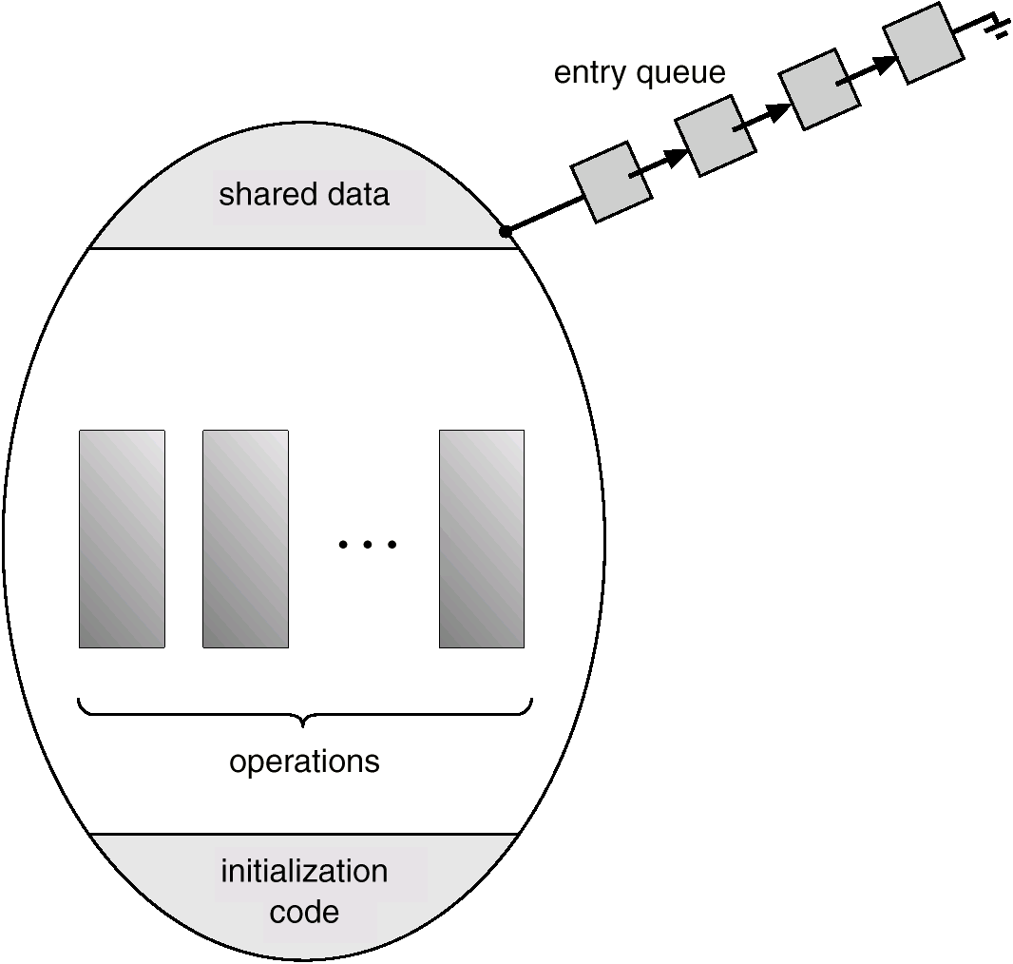
Monitor

Slide 57
Monitor Solution to bounded buffer problem
Boundedbuffer bb;
void producer(){
char x;
while (true){
produce(x);
bb.append(x);
}
}
void consumer(){
char x;
while (true){
bb.take(x);
consume(x);
}
monitor boundedbuffer{
char buffer [N];
int nextin, nextout, count;
cond notfull, notempty;
void append(char x){
if (count == N) cwait(notfull);
buffer[nextin] = x;
nextin = (nextin + 1) % N;
count++ ;
csignal(notempty);
}
void take (char x){
if (count == 0) cwait(notempty);
x = buffer[nextout];
nextout = (nextout + 1) % N;
count--;
csignal(notfull);
}
nextin = 0; nextout = 0; count = 0;
}

